Slide 1

PYFAANG Stock Analysis
Pei-Ju Wu (Emily)
UC Berkeley Bootcamp

Slide 2
Introduction & objectives
Analyze FAANG stock data from 2012 to 2022. Gain insights into price trends, trading volumes, and market capitalization. Compare performance to the S&P 500 index. Provide investment recommendations based on risk profiles.

Slide 3

Data sources & DATA PROCESS & VISUALIZATION
YAHOO-FIN PYTHON OPEN-SOURCE LIBRARY
ALPHA VANTAGE API
PANDAS
MATPLOTLIB
SEABORN

Slide 4
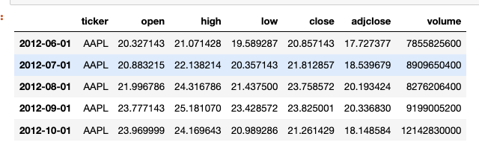
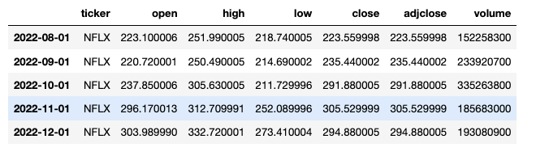
DATA FECTHING
The FAANG stock data covers 10 years on a monthly basis, starting from June 1, 2012, after the IPO of Meta in May 2012.
It includes monthly open, close, high, low prices, adjusted close prices, and trading volume.
Notes:
- it accounting for stock splits, dividends, and other corporate actions.

Slide 5
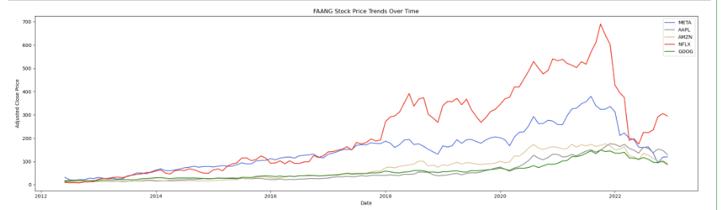
Price trends
The trend for FAANG companies shows a consistent increase in stock prices over the analyzed period.
Notes:
the 10-year period

Slide 6
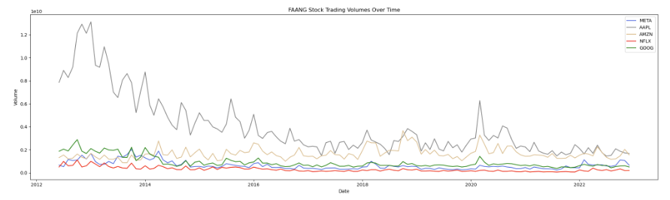
Trading volumes
Overall, there was a decrease in the trading volume trend. However, in the years of 2018 and 2020, there was a notable increase in trading volumes.
Notes:
From 2012 to 2022, the dataset reveals a pattern where the FAANG stock prices were increasing while the trading volumes were decreasing before 2020, suggesting a potential "reduction of market participation" and a potential indication of a price reversal. Now, let's dive deeper into the dataset to examine the dynamics of the FAANG stocks during the pandemic.

Slide 7
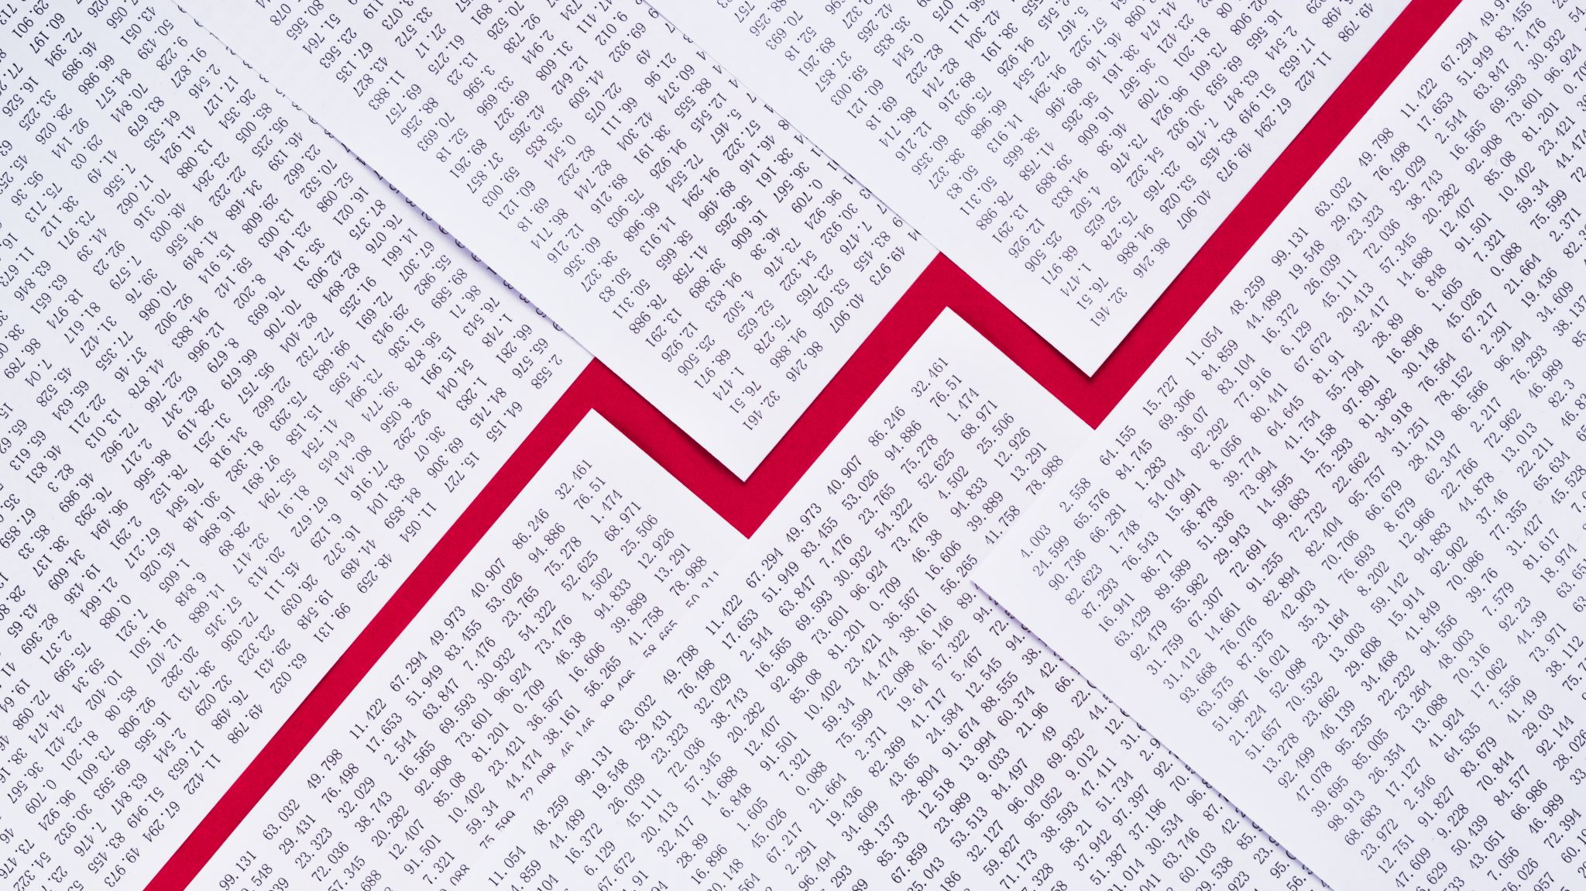
The Impact of COVID on the Stock Performance of FAANG Companies
Notes:
we goona highlight the impact

Slide 8
Focus on
Price Trends
Trading Volumes
Comparison of Market Cap
Pre-pandemic
During pandemic
Post-pandemic

Slide 9
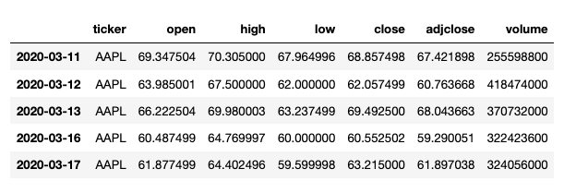
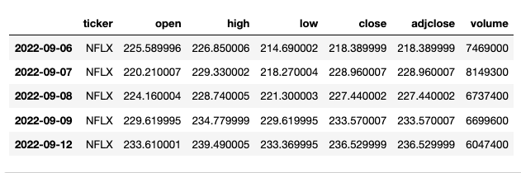
Covid dataset
The COVID period from March 11, 2020, to September 12, 2022, is represented using daily intervals to analyze the FAANG stock prices.
Notes:
we gonna use adjclose price for better reference.

Slide 10
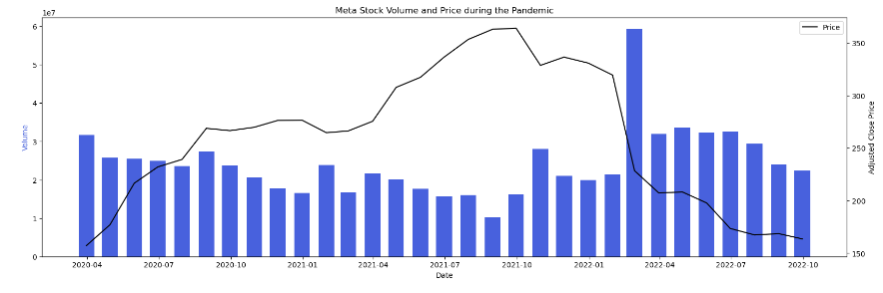

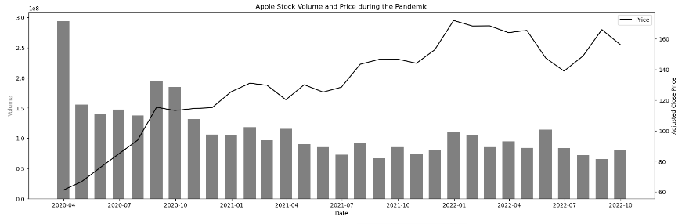

PRICE TRENDS & TRADING VOLUMES
Notes:
Resample the data for more clear visualization
the bar graph represents the trending volume, and the line graph represents the prices trend for each company.

Slide 11
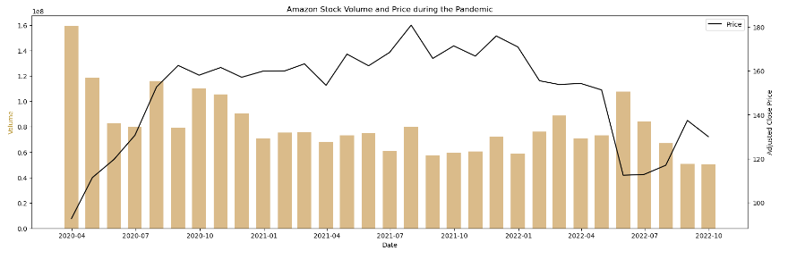
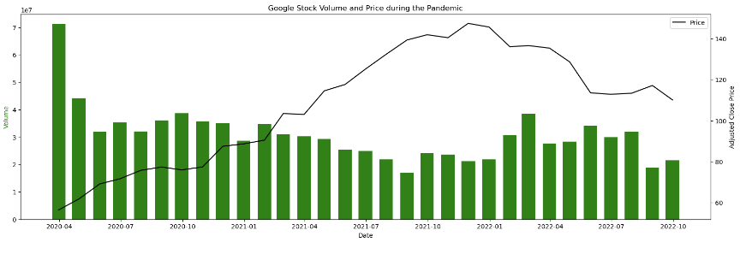


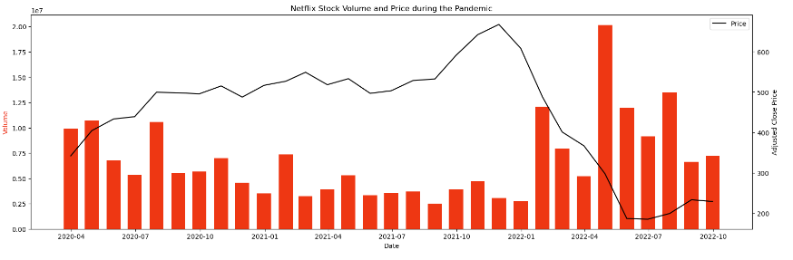
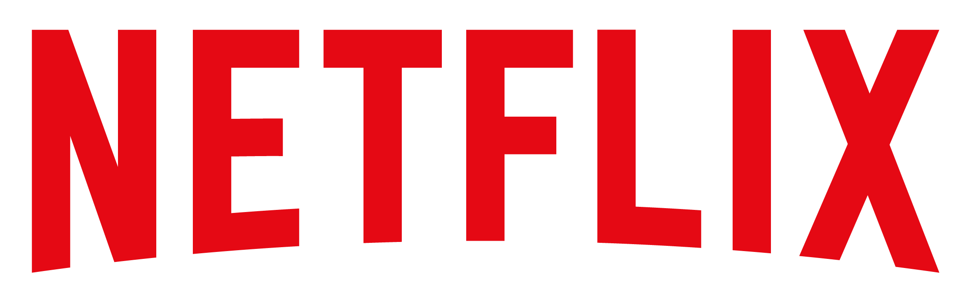
FAANG stocks initially dropped during the pandemic, except for Netflix. They later recovered, reflecting investors’ confidence.
Notes:
- point out netflix

Slide 12
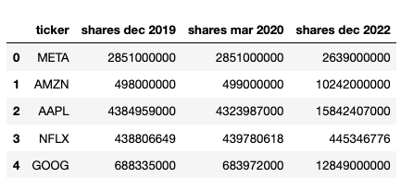
Share Data
Outstanding share data:
Pre-Pandemic (December 2019)
Pandemic (March 2020)
Post-Pandemic (December 2022)
Notes:
To calculate the market cap, we used the outstanding share data multiply by the stock price.
we wanna compare the market cap cahnge among 3 different time period which are pre-covid, during covid and pst-covid.

Slide 13
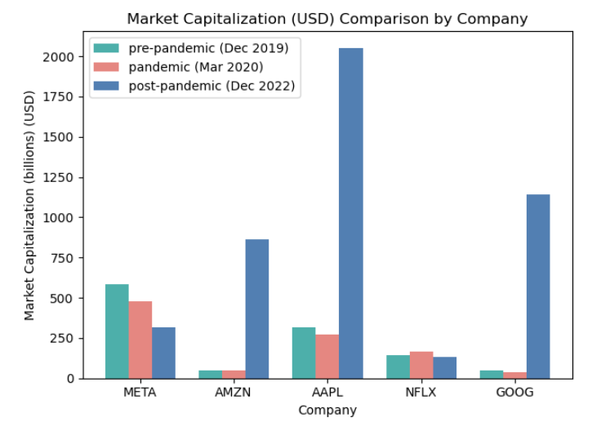
Calculating & comparing Market Cap
Multiplying Share Data with Stock Prices
During COVID Netflix Holds Strong
Amazon, Google, and Apple Stage Impressive Recovery in Post-COVID Era
Notes:
we can see that during covid netflix holds strong- point out

Slide 14
Comparison of S&P 500 Index vs FAANG Stocks

Slide 15
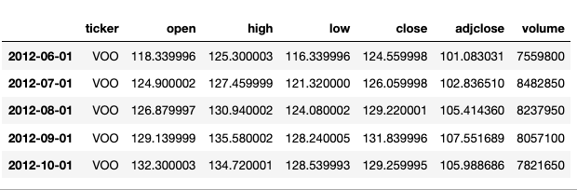
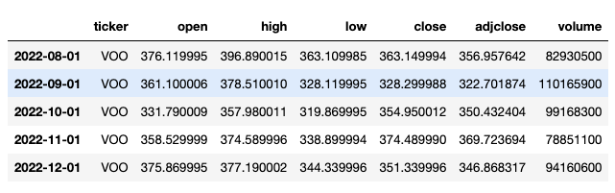
FECTCHING SP500 INDEX DATA
Utilizing the same interval and time span as the FAANG company data, the VOO ETF closely mirrors the performance of the S&P 500 Index.

Slide 16
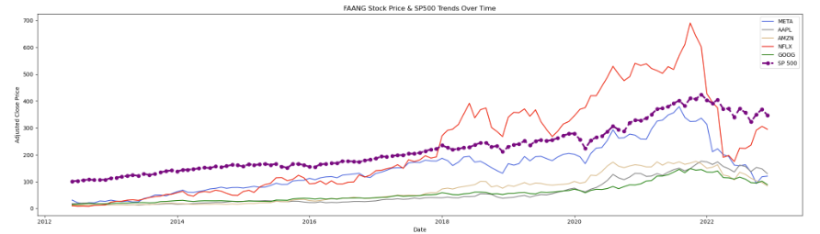
PRICE TRENDS COMPARSION
Most FAANG companies displayed a similar trend, aligning with the S&P 500 Index.
Notes:
However, Netflix showed a remarkable increase from 2018 to 2021, outperforming the US market. In 2022, the stock price began to decline, indicating mean reversion.

Slide 17
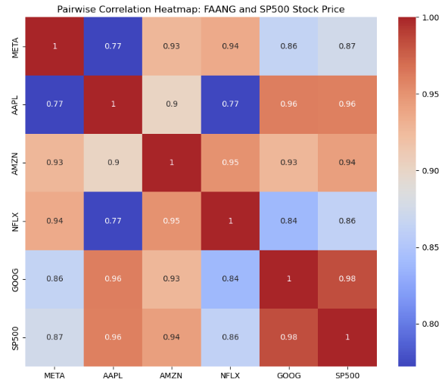
Correlation heatmap
Heatmap shows positive correlation between FAANG stocks and S&P 500, indicating a close relationship.
Notes:
the is a pairwise correlation heatmap of FAANG company and sp500 stock price.
since FAANG company are part of the S&P 500 index, here we use the correlation heat map to disentangle the effect of FAANG company on the S&P 500 index and also the correlation among them.

Slide 18
Summary
FAANG stocks demonstrate consistent price increase, making them attractive investments.
Apple, Google, and Amazon are relatively stable, while Netflix and Meta show higher volatility.
FAANG stocks offer long-term growth opportunities with different levels of risk and potential rewards based on individual preferences.
Notes:
based on all the data i mentioned above, we can conclude that first,

Slide 19
THANK YOU

